Slide 1
Game Schedular
Nalamothu Nikhitha Chowdhary
03-04-2019

Slide 2
Problem Statement:
In this GAME SCHEDULAR application ,scheduling the games based on date and time.
In this application player is convenient enough to know the games schedule.

Slide 3

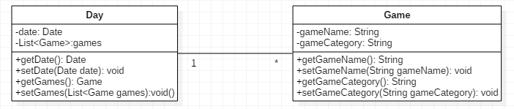
POJO/DTO/Bean classes:

Slide 4
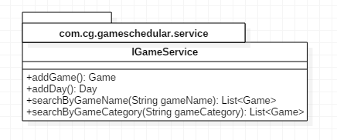
Service Interface:

Slide 5
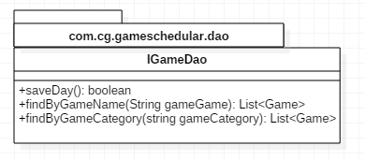
DAO interface:

Slide 6
THANK YOU

